Slide 1

Cisco Ideathon 2022
Vikhas S g
Psg institute of technology & applied research

Slide 2
introduction
These days, people use mobile phones widely and wisely all over the place.
Therefore, the web application is the best solution to what the average user needs to use to detect the expiration date of the medicine.
As web apps can be used both in mobile handsets and PC’s/Laptops via web browsers and it does not consumes any memory space as mobile app does.
The consumption of an expired medicine may cause severe harm to the patients. The expiry date paper label on medications may be torn or creased over the course of time.
The user can utilize the camera at smartphone/laptops to scan the QR code to detect the details of the medicine including expiry date.

Slide 3
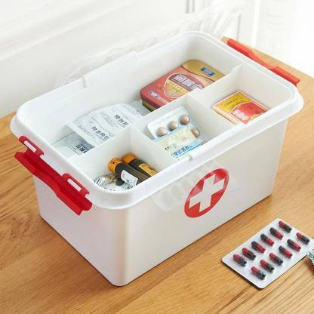
Problem statement
Every household has a box of general medicines/ specific medicines that are present for our consumption. While the medicine is purchased we make it a point to check the date of expiry, however over a period of time we ignore to validate if the medicines available in our house are still under the period of expiry.
Question: Leverage technology to ensure that we have an easy mechanism to identify which of the medicines are still okay for consumption.

Slide 4
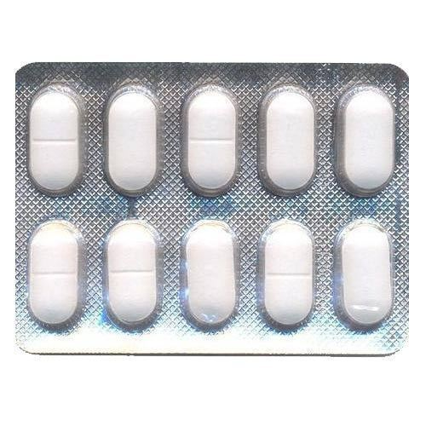
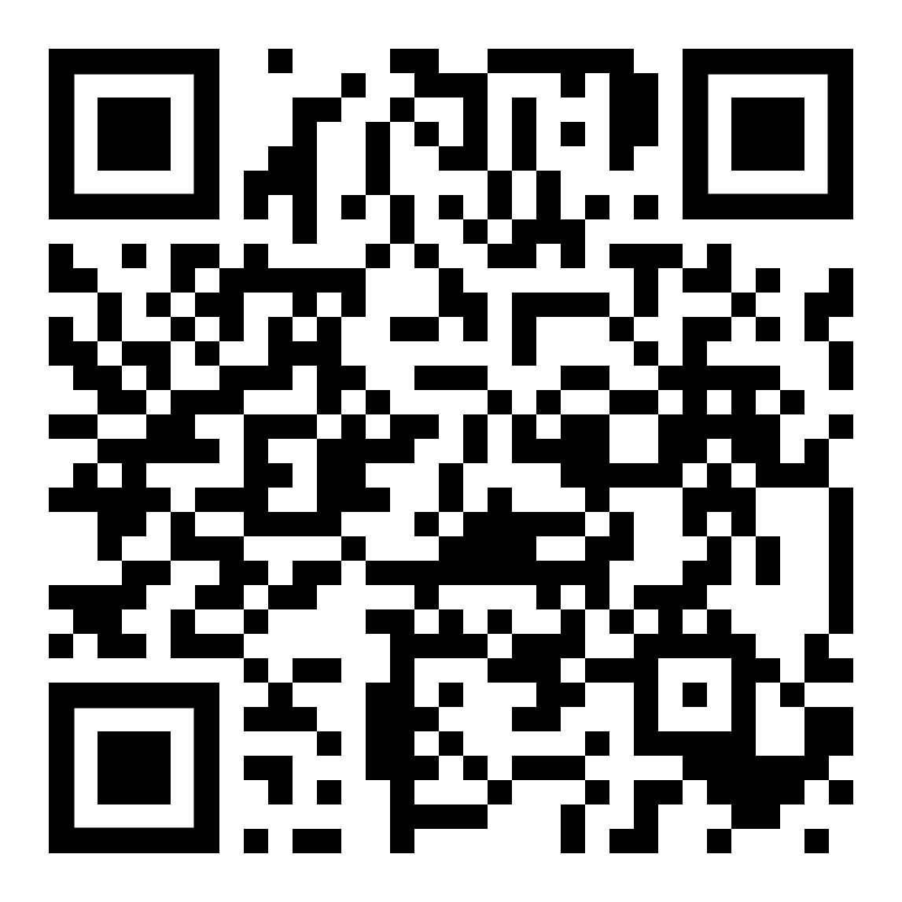
Proposed solution
Medicine expiry date detection is a system that help to facilitate the users to know the details of the medicine by using a web application QR-code reader.
The details of medicine such as name of medicine, function of medicine, expiry date of medicine, drug company that produces the medicine and pricing will be created using QR-code from hospital medical department or pharmacy.
By placing QR codes on top of each tablets helps to make sure that it does not get damaged even after taking medicine for consumption.
With this web application, every user have login credentials to enter into their account and they can able to store details about their medicines by scanning QR code present on it.

Slide 5
Methodology
In the proposed system, the application has five features such as list medicine, add medicine by scanning, view the details of medicine, create the note, calendar for reminder feature.
List Medicine: By using this feature, the user can view the list of medicines in the database.
Add medicine: In this feature, the user can add the medicine and the details of medicine in the database by scanning the QR code on the medicine.
View Medicine: This feature allows the user to view the details of the chosen medicine.
Create note: The user can use this interface to note down some information received from medical officers.
Calendar: This feature is used as a reminder of expiry date. Also, user can select this feature to create events or set date of appointment with medical officer.

Slide 6
Workflow
STAGE 01
Login with user
STAGE 03
STAGE 02
Add medicine name and expiry date by scanning QR code.
STAGE 04
STAGE 05
Search the medicine by scanning QR code.
Credentials.
Stores the details
in the database(MongoDB).
View all medicines
list of that particular user.

Slide 7
Proposed Technology stack
Frontend: HTML, CSS, JS, EJS
Backend: Node.js
Database: MongoDB

Slide 8
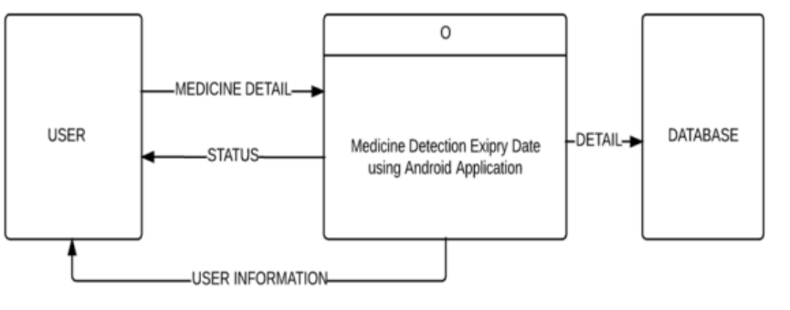
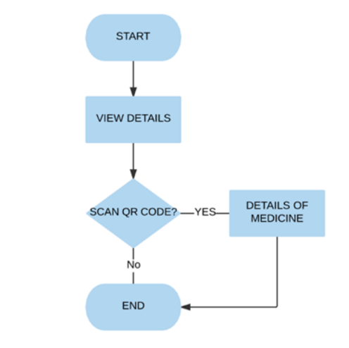
implementations
QR Code is a two dimensional (2D) encrypted barcode with a matrix structure which consists of black modules arranged in a square grid on a white background.
This barcode can serve as a mobile bridge between physical platforms and digital information.
With innovative QR-code scanning technology, user will be able to seamlessly identify medicine and know an expiry date of medicine using smartphone/laptops.
Fig-1: Add medicine interface
Fig-2: Interface design to View the Details of medicine in Proposed System

Slide 9
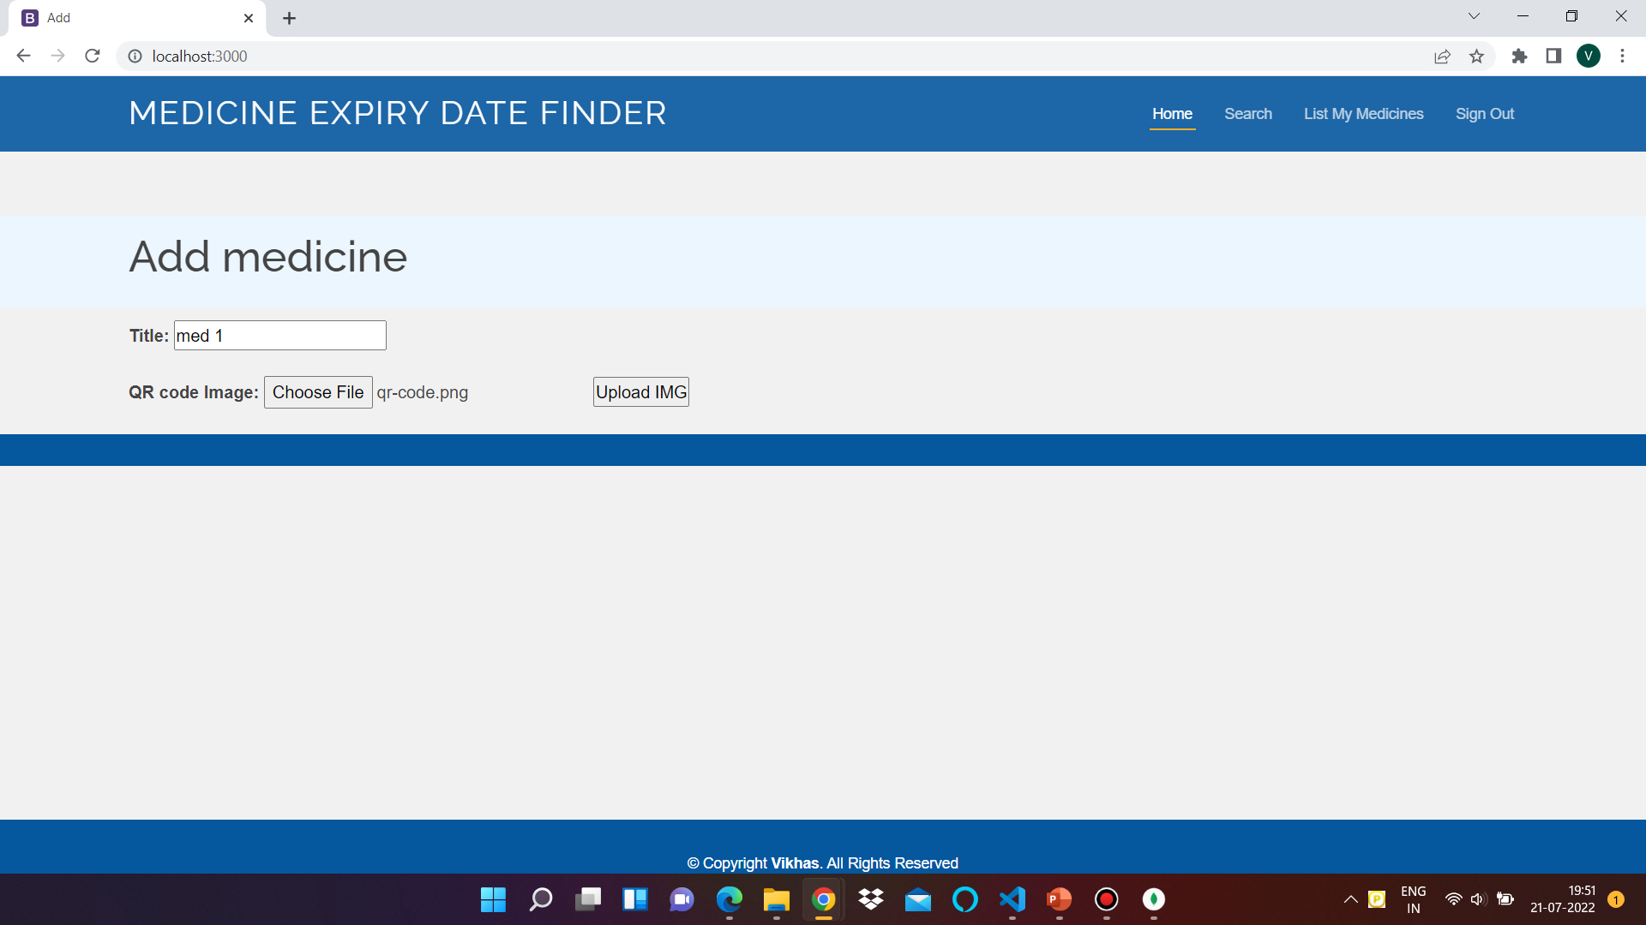
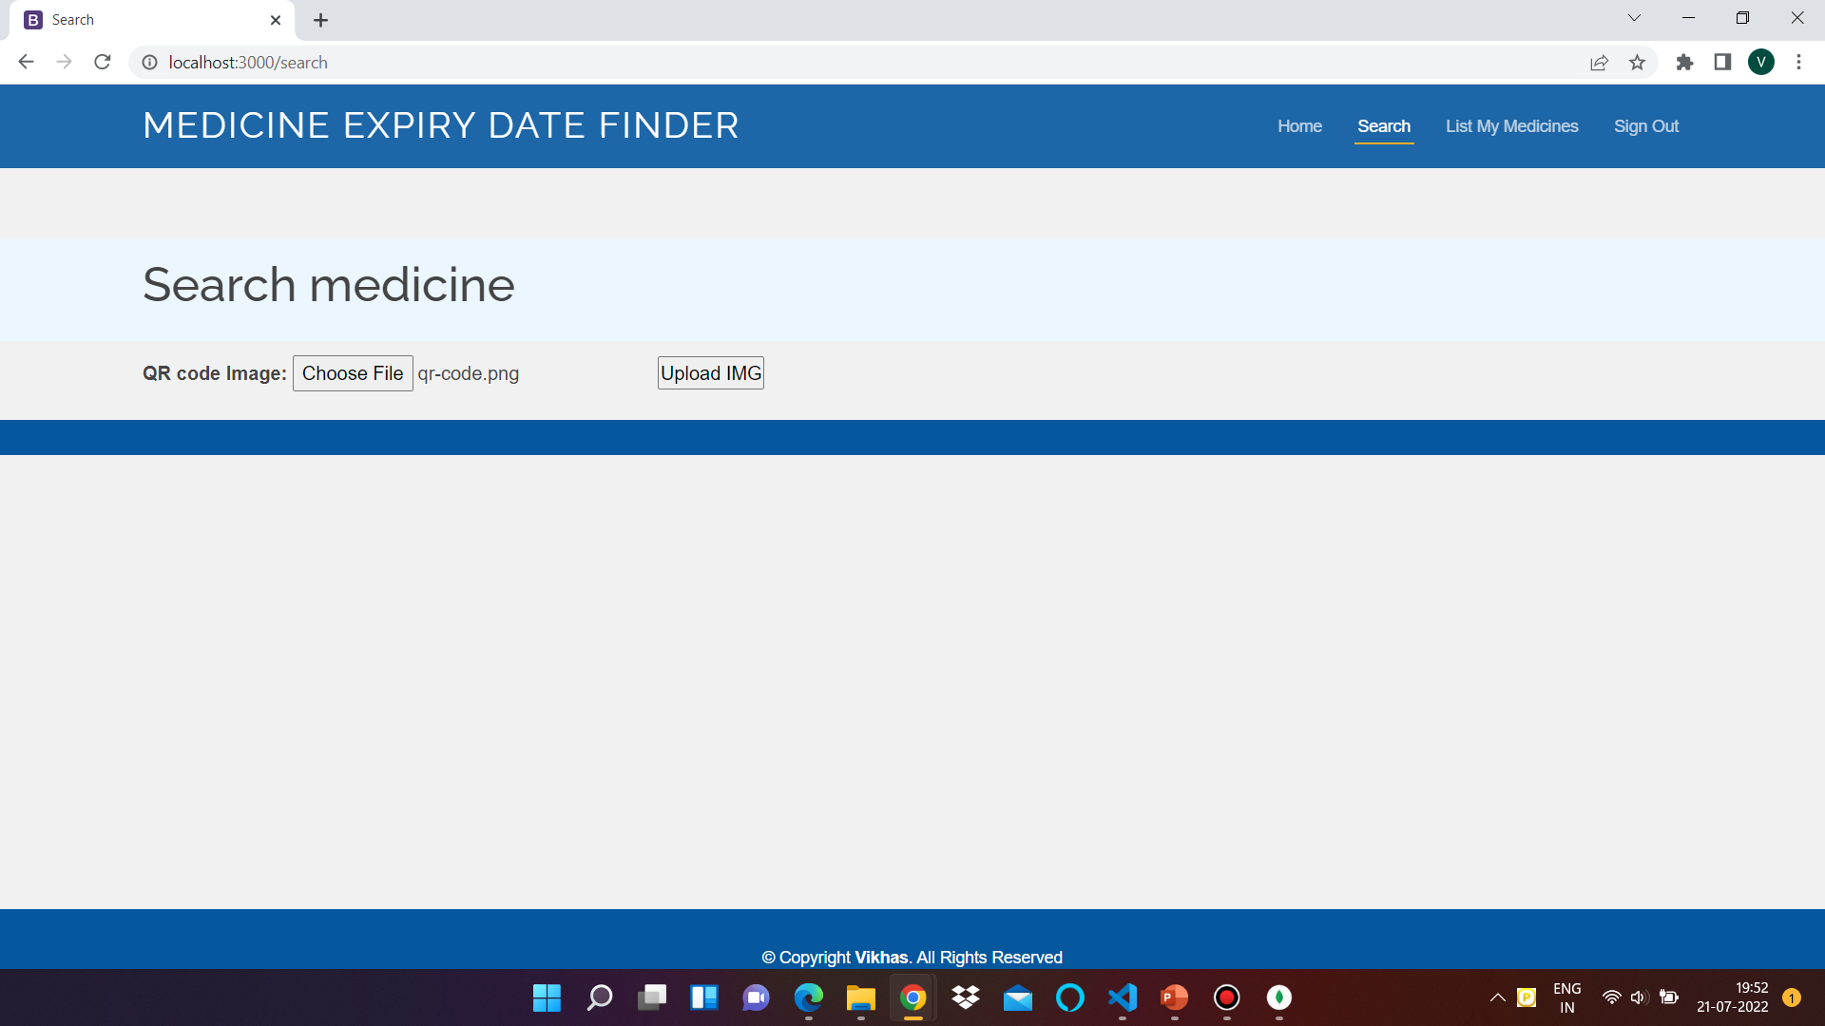
Implementations
Fig-3: Uploading QR image
Fig-4: Search using QR code

Slide 10
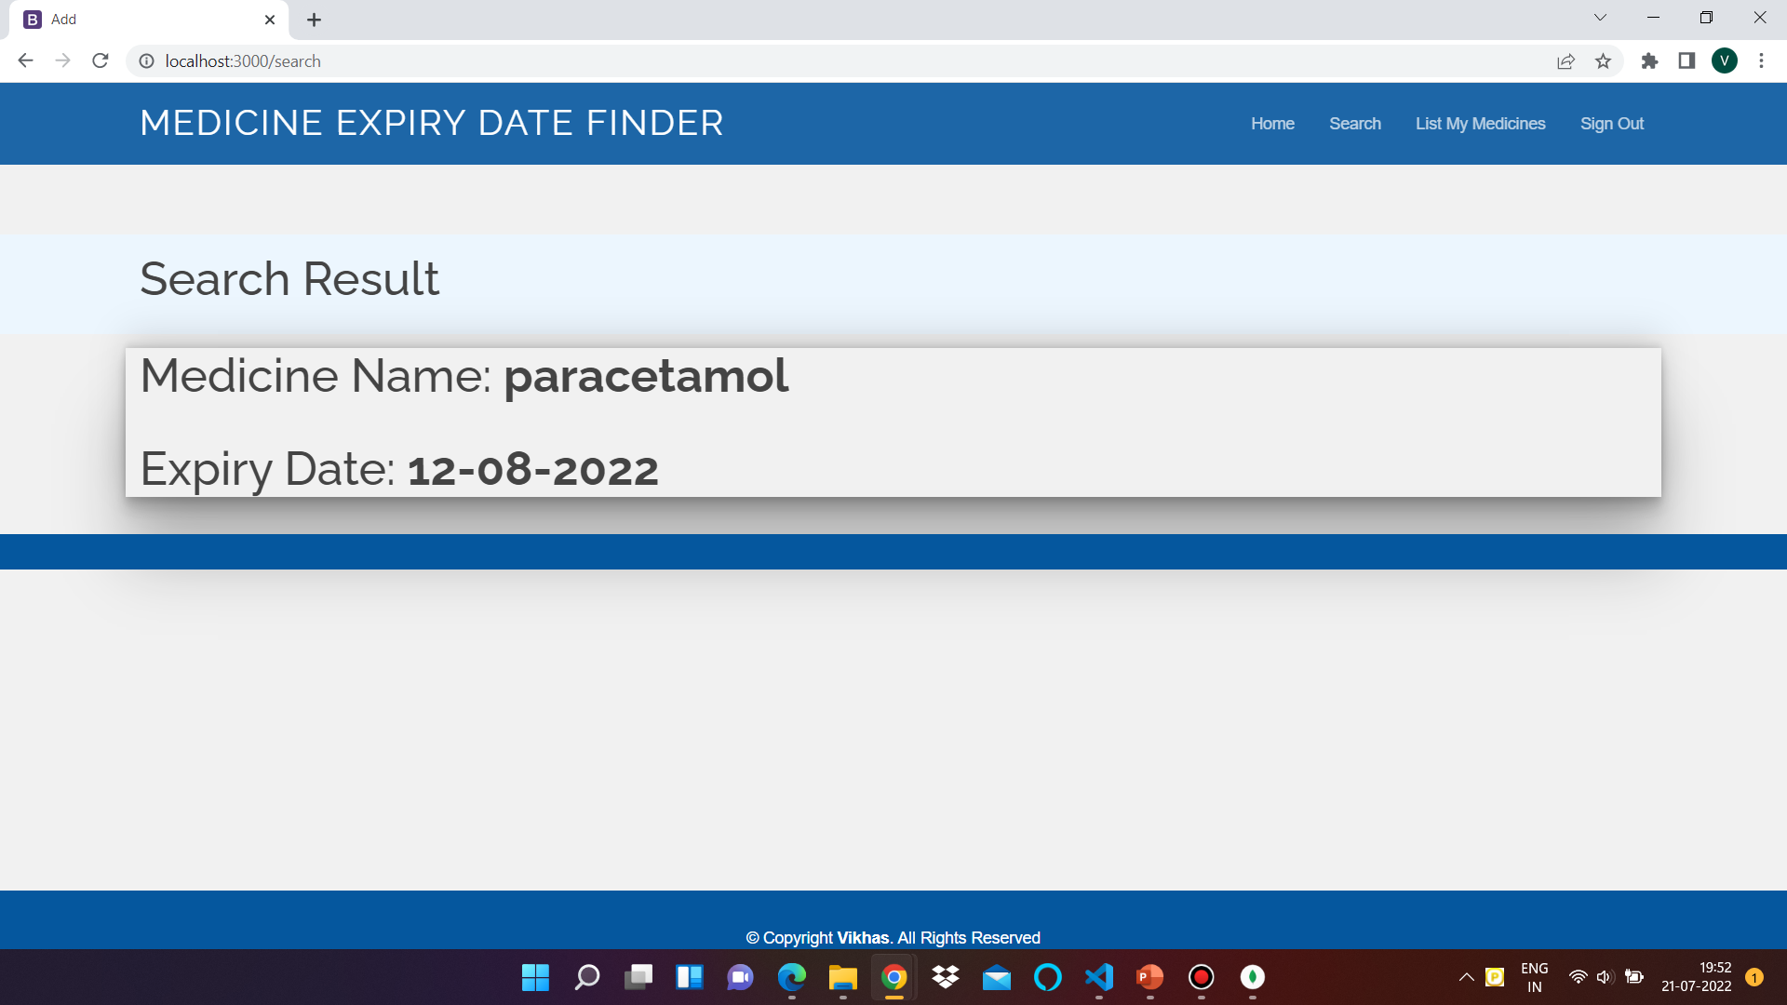
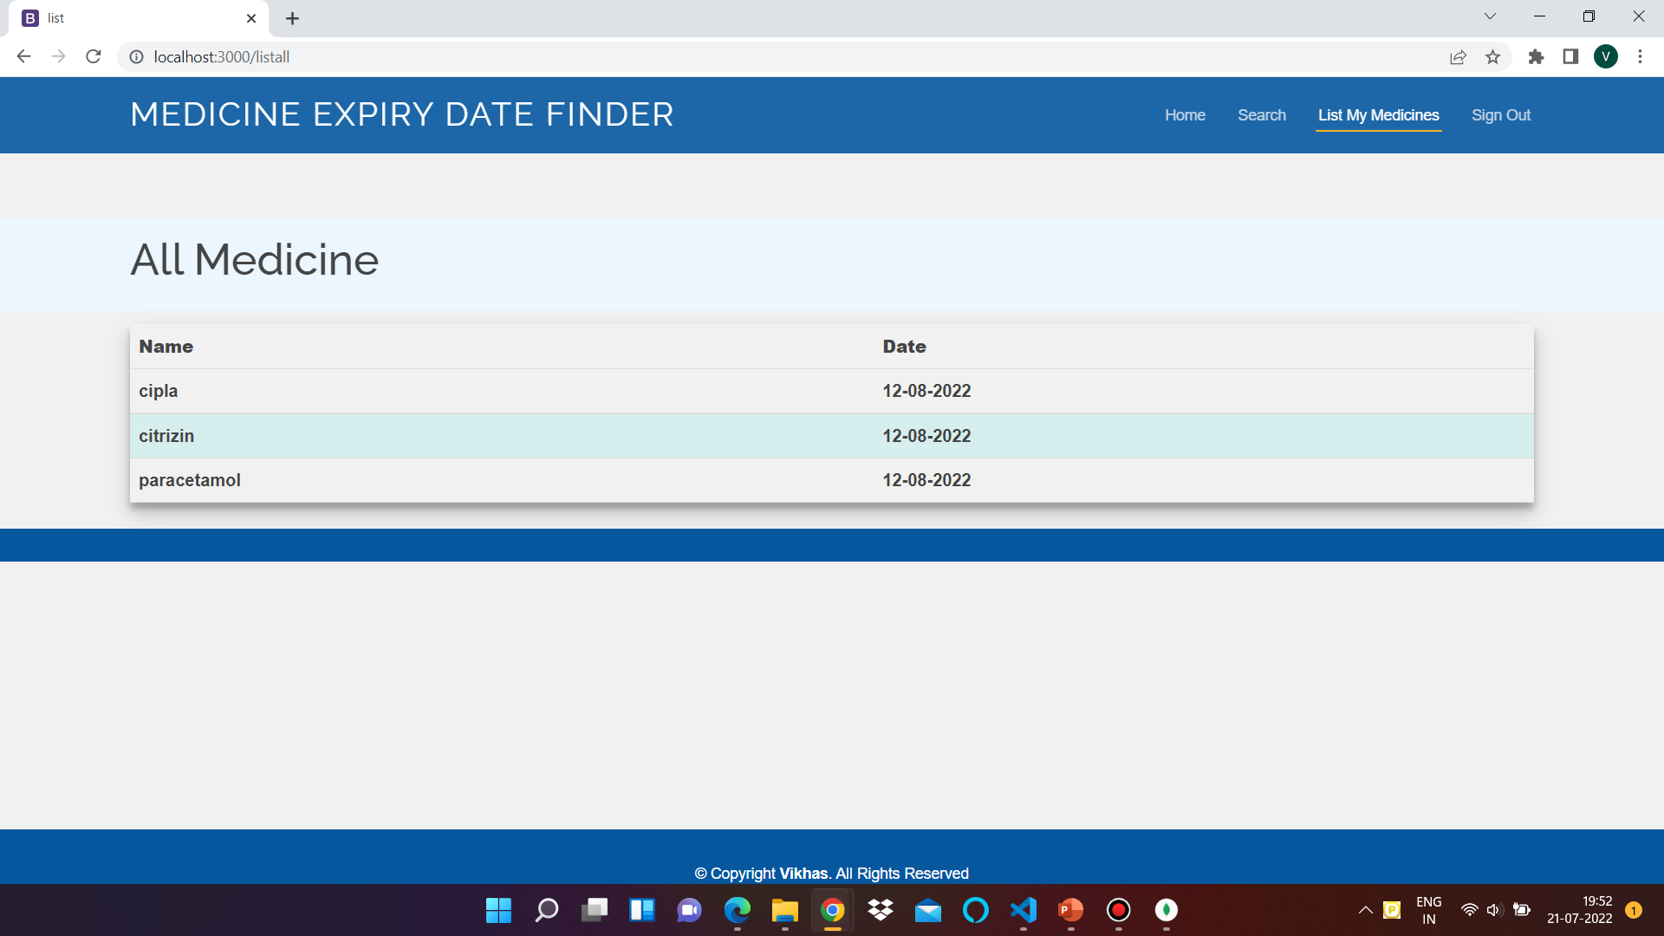
Implementations
Fig-5: Search result
Fig-6: All medicines list

Slide 11
THANK YOU

